Slide 1
display
Taught by Yossef Ayman Zedan

Slide 2
Notation
Display utility classes that apply to all breakpoints , from xs to xxl, have no breakpoint abbreviation in them. This is because those classes are applied from min-width: 0; and up, and thus are not bound by a media query. The remaining breakpoints, however, do include a breakpoint abbreviation.
As such, the classes are named using the format:
.d-{value} for xs
.d-{breakpoint}-{value} for sm, md, lg, xl, and xxl.

Slide 3
Notation
Where value is one of:
none
inline
inline-block
block
grid
table
table-cell
table-row
flex
inline-flex

Slide 4
Notation
Where value is one of: Note: The media queries affect screen widths with the given breakpoint or larger. For example, .d-lg-none sets display: none; on lg, xl, and xxl screens.
none
inline
inline-block
block
grid
table
table-cell
table-row
flex
inline-flex

Slide 5

Examples
<div class="d-inline p-2 bg-primary text-white">d-inline</div>
<div class="d-inline p-2 bg-dark text-white">d-inline</div>

Slide 6

Example 2
<span class="d-block p-2 bg-primary text-white">d-block</span>
<span class="d-block p-2 bg-dark text-white">d-block</span>

Slide 7
Hiding elements
For faster mobile-friendly development, use responsive display classes for showing and hiding elements by device. Avoid creating entirely different versions of the same site, instead hide elements responsively for each screen size.
To hide elements simply use the .d-none class or one of the .d-{sm,md,lg,xl,xxl}-none classes for any responsive screen variation.
To show an element only on a given interval of screen sizes you can combine one .d-*-none class with a .d-*-* class, for example .d-none .d-md-block .d-xl-none .d-xxl-none will hide the element for all screen sizes except on medium and large devices.

Slide 8
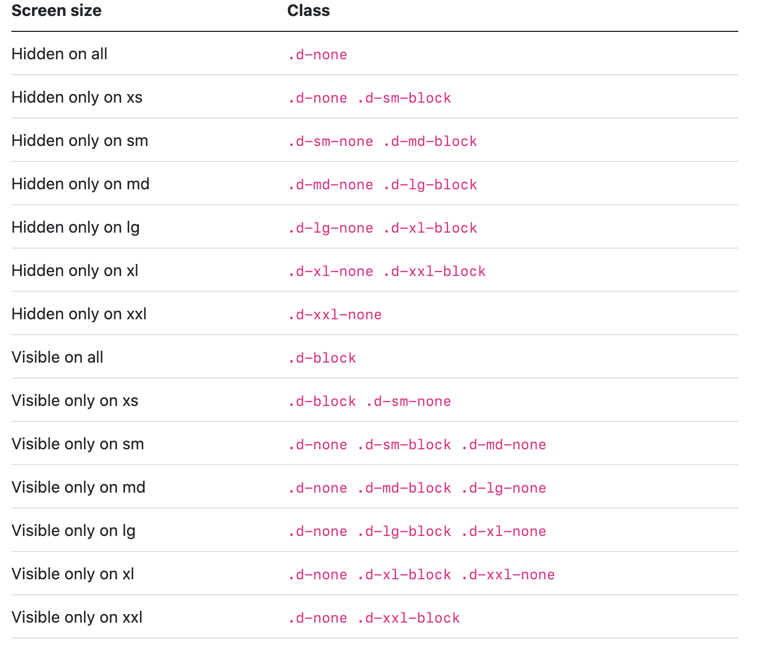
Hiding elements

Slide 9
Example 1
<div class="d-lg-none">hide on lg and wider screens</div>
<div class="d-none d-lg-block">hide on screens smaller than lg</div>

Slide 10
Display in print
Change the display value of elements when printing with our print display utility classes. Includes support for the same display values as our responsive .d-* utilities.
. d-print-none
.d-print-inline
.d-print-inline-block
.d-print-block
.d-print-grid
.d-print-table
.d-print-table-row
.d-print-table-cell
.d-print-flex
.d-print-inline-flex

Slide 11

Example 1
The print and display classes can be combined.
<div class="d-print-none">Screen Only (Hide on print only)</div>
<div class="d-none d-print-block">Print Only (Hide on screen only)</div>
<div class="d-none d-lg-block d-print-block">Hide up to large on screen, but always show on print</div>

Slide 12
Exa

